Slide 1
APPLICAION STORE PROJECT
Group MEMBERS
Rishi Hemwani
MAYANK SHARMA
KOMAL AMBEKAR
SAYALI BORSE

Slide 2
INTRODUCTION ON APP STORE
An app store (or app marketplace) is a type of digital distribution platform for computer software, often in a mobile context. Apps provide a specific set of functions which, by definition, do not include the running of the computer itself. Apps are designed to run on specific devices, and are written for a specific operating system (such as iOS, macOS, Windows, or Android). Complex software designed for use on a personal computer, for example, may have a related app designed for use on a mobile device.
App stores typically take the form of an online store, where users can browse through these different app categories, view information about each app (such as reviews or ratings), and acquire the app (including app purchase, if necessary - many apps are offered at no cost). The selected app is offered as an automatic download, after which the app installs. Some app stores may also include a system to automatically remove an installed program from devices under certain conditions, with the goal of protecting the user against malicious software.

Slide 3

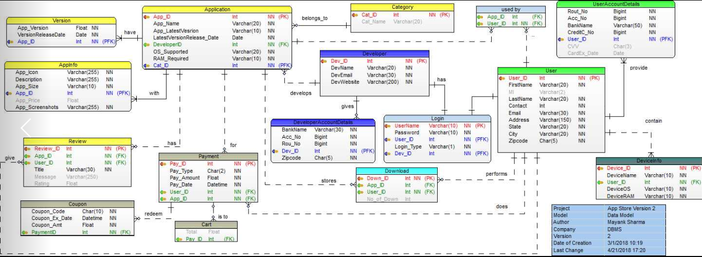



APP STORE MODEL

Slide 4
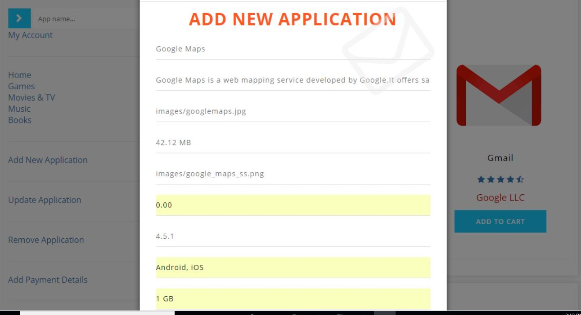
FLOW OF THE APPSTORE APPLICATION
Application Table:
Add a new application in app store by clicking “Add a New Application “ on the left navigation bar

Slide 5

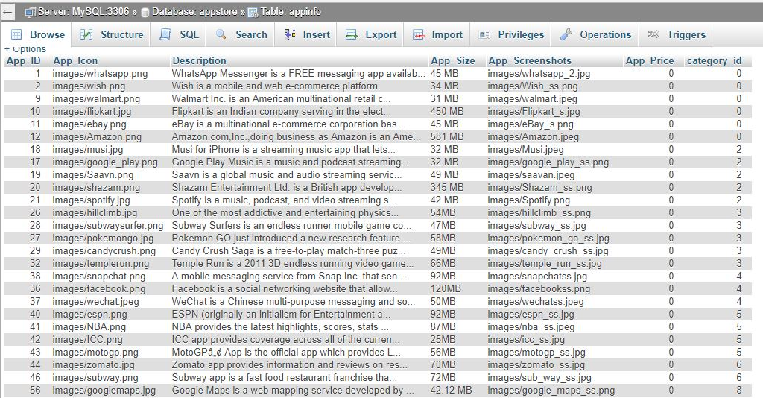
FLOW OF THE APPSTORE APPLICATION
Application Table:
After adding an application the required information gets stored in the “app_info” and “application” table.

Slide 6
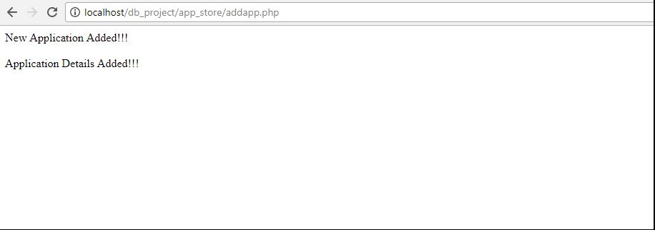
FLOW OF THE APPSTORE APPLICATION
Application Table:
After inserting in the database a final message gets printed saying ”New application added and application details added”

Slide 7
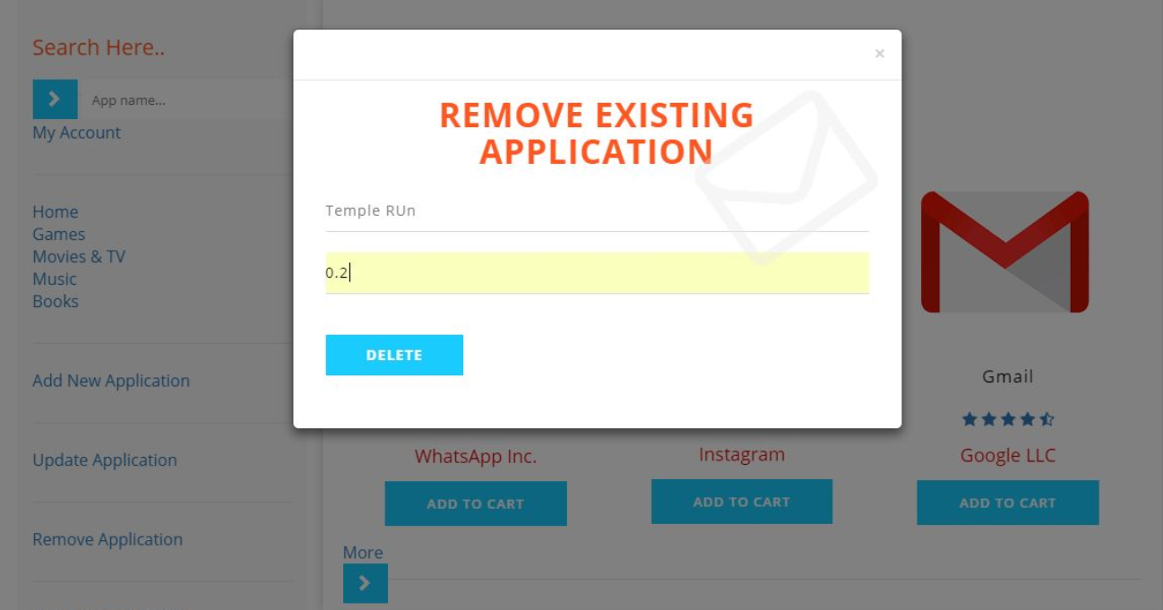
FLOW OF THE APPSTORE APPLICATION
Application Table:
When an applicaion needs to be removed/deleted click on the option given at the left naviaation bar.

Slide 8
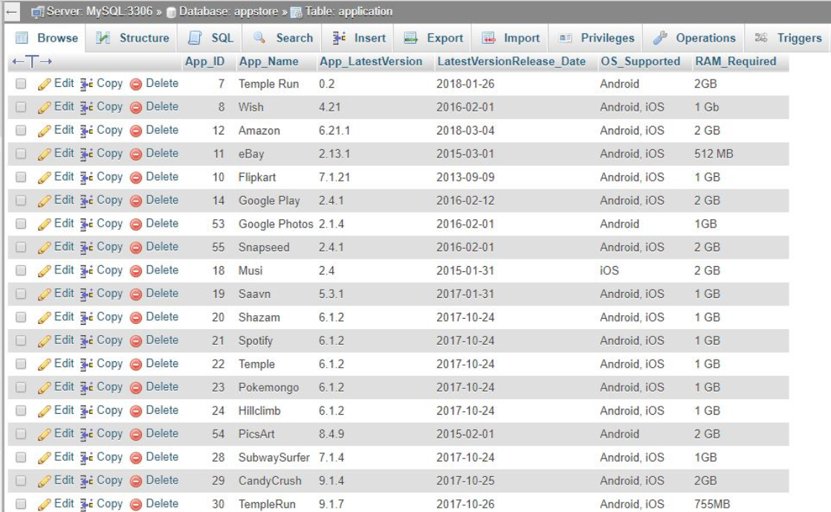
FLOW OF THE APPSTORE APPLICATION
Application Table:
Before removing an app the database contains the temple run app for example
After removing the app the database it will have the temple run app row deleted.

Slide 9
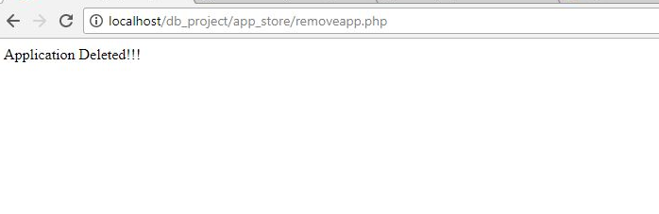
FLOW OF THE APPSTORE APPLICATION
Application Table:
After the app gets deleted in the database a final message gets printed saying “Application Deleted”

Slide 10
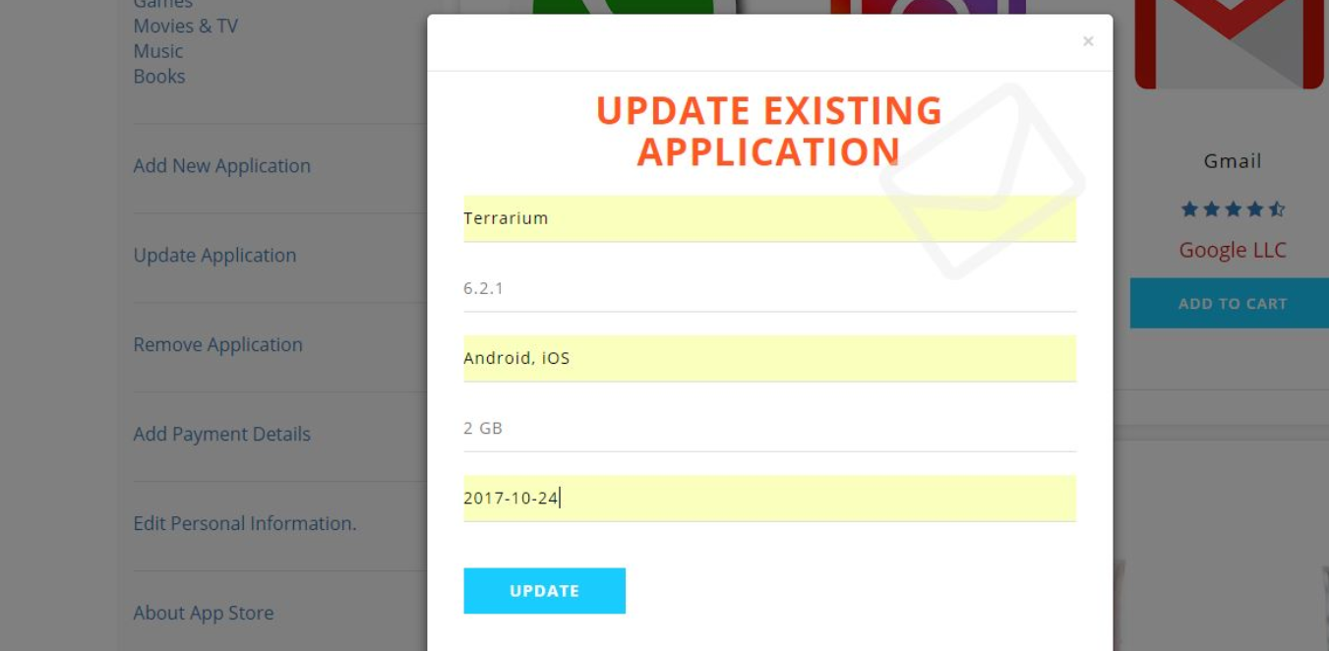
FLOW OF THE APPSTORE APPLICATION
Application Table:
When an applicaion needs to be updated click on the option given at the left naviaation bar.

Slide 11
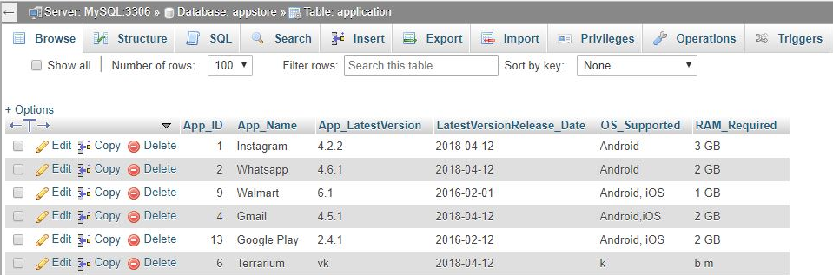
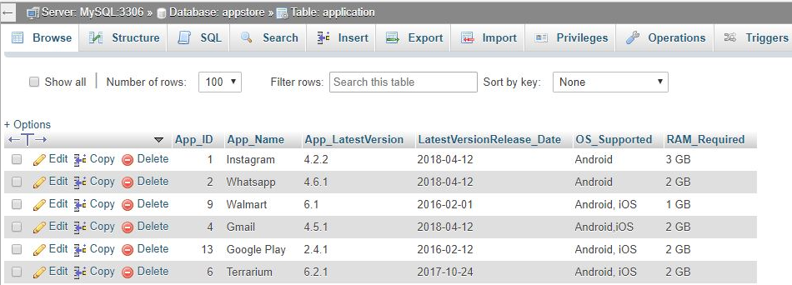
FLOW OF THE APPSTORE APPLICATION
Application Table:
Before updating the Terrarium app the database contained following details
After the app gets updated the database will have the updated details.

Slide 12
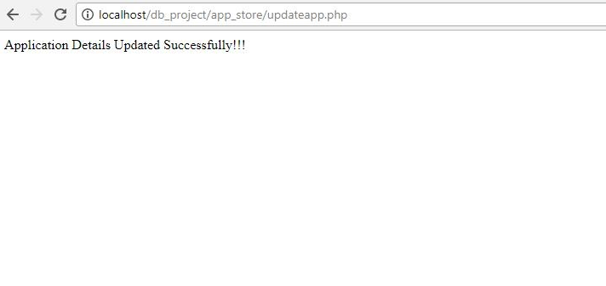
FLOW OF THE APPSTORE APPLICATION
Application Table:
After the app gets updated in the database a final message gets printed saying “Application Details updated successfully”

Slide 13
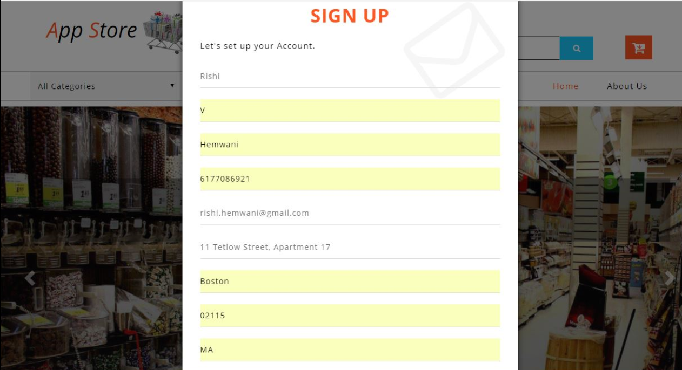
FLOW OF THE APPSTORE APPLICATION
User Table:
When any user needs to signup, click on the option given at the top-”Sign Up”

Slide 14
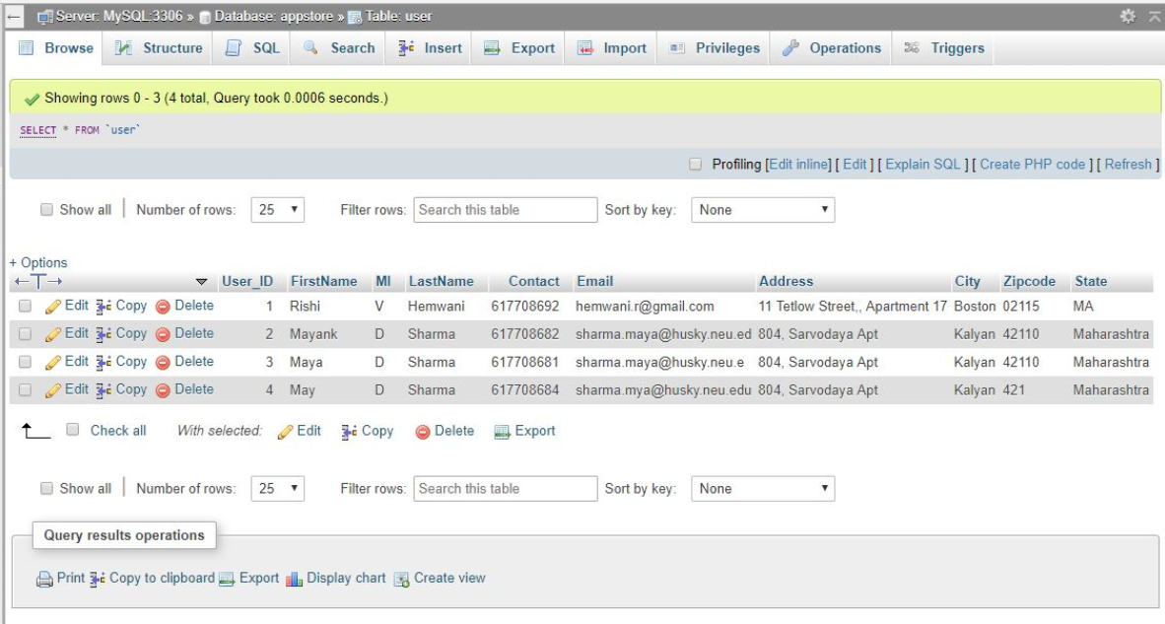
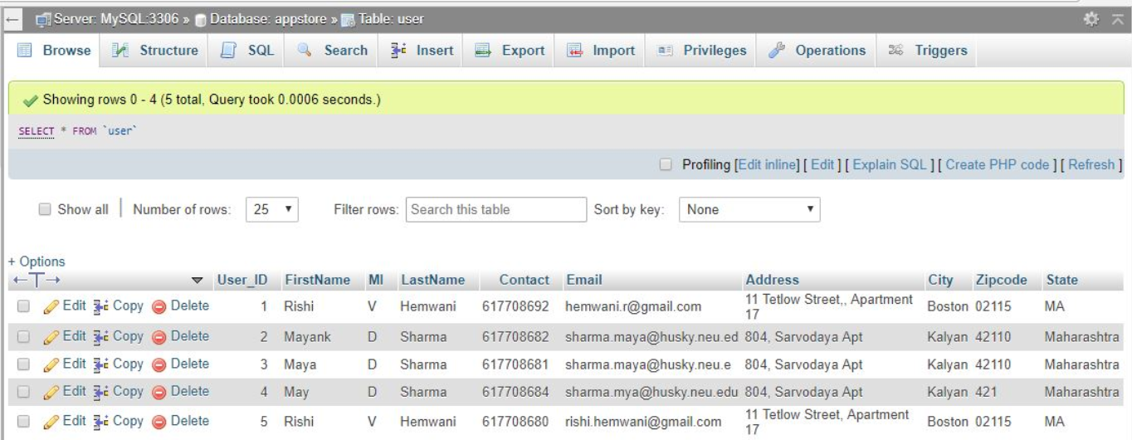
FLOW OF THE APPSTORE APPLICATION
User Table:
Before the new user signed up the user table had following entries.
After the user signs up the database will have the new user details as the recent entry.

Slide 15
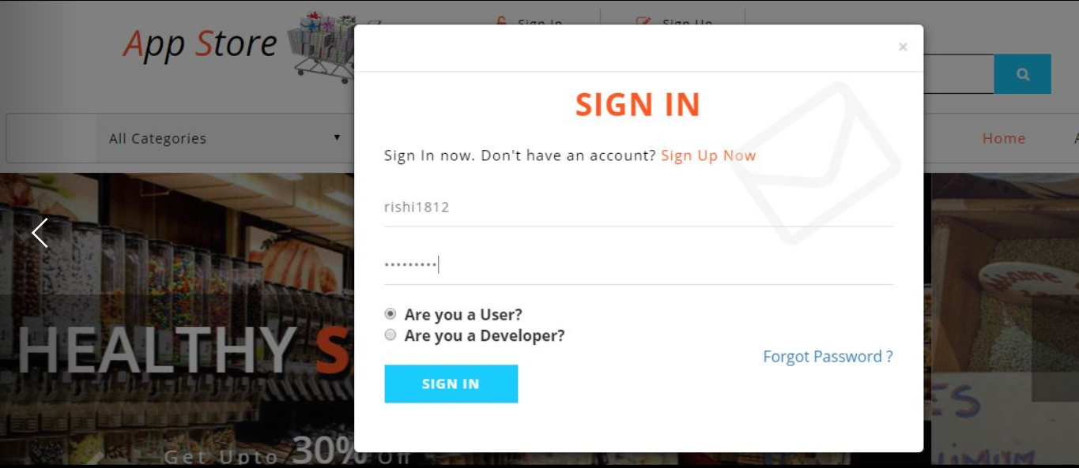
FLOW OF THE APPSTORE APPLICATION
User Table:
When any new user wants to sign in, click on the option given at the top

Slide 16
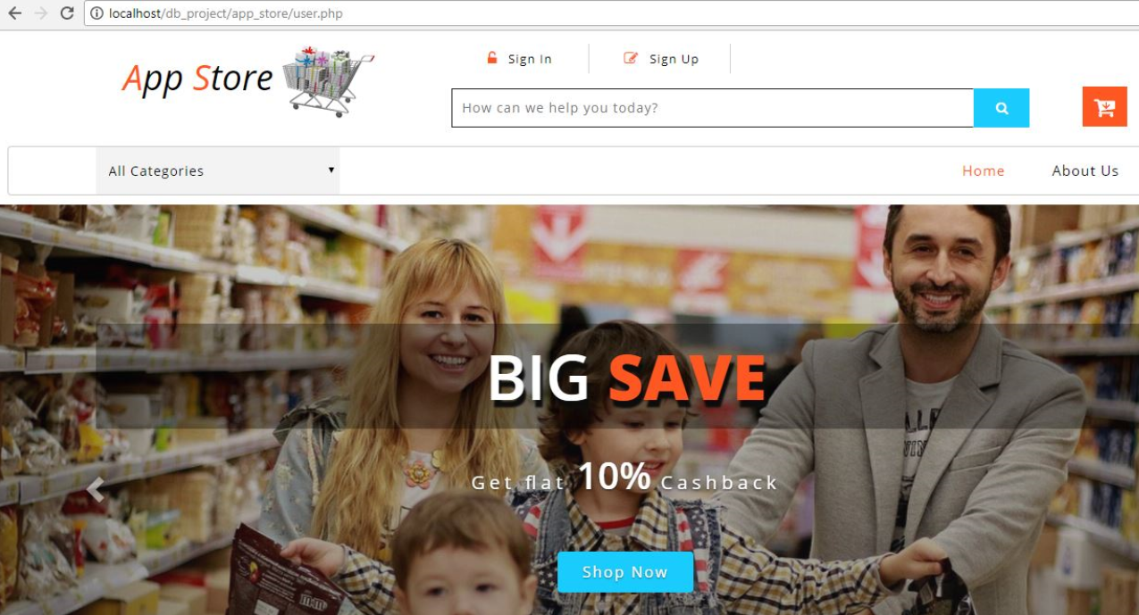
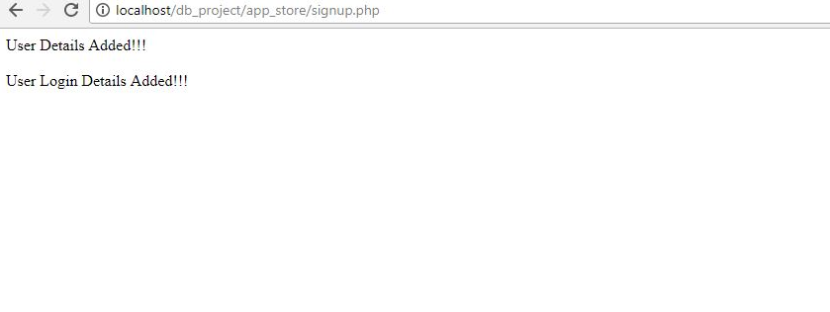
FLOW OF THE APPSTORE APPLICATION
User Table:
After the new user logins the page gets redirected to main page.
After the user signs up the following message gets displayed.

Slide 17
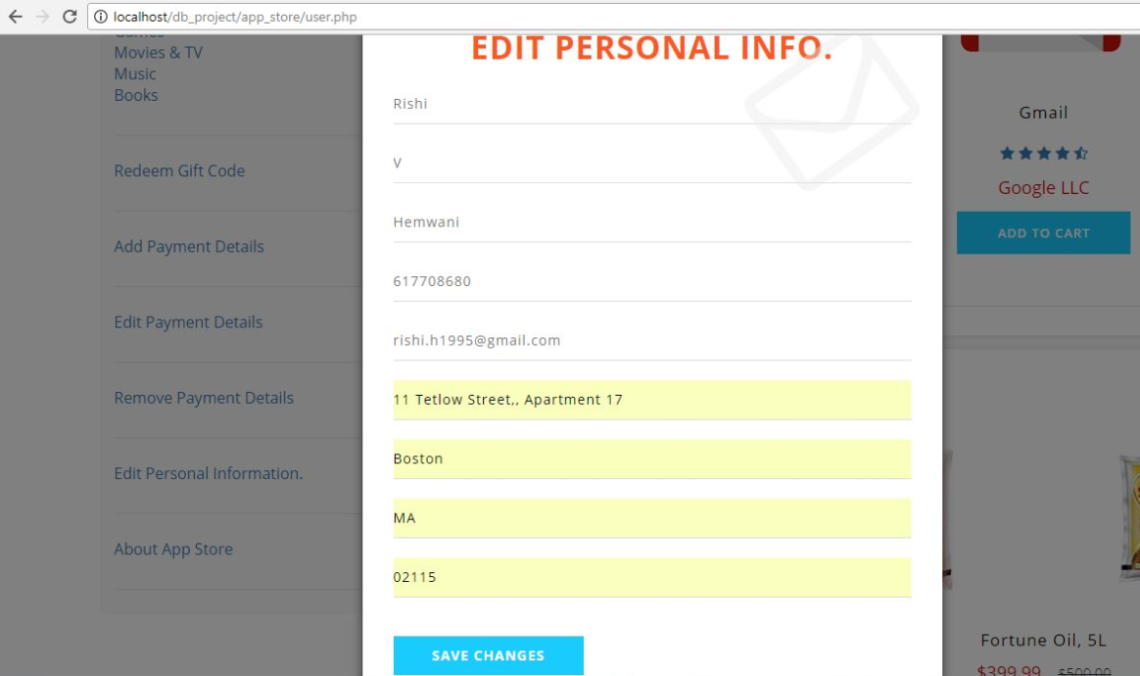
FLOW OF THE APPSTORE APPLICATION
User Table:
When any user needs to update his/her details ,click on the option given at the left navigation bar

Slide 18
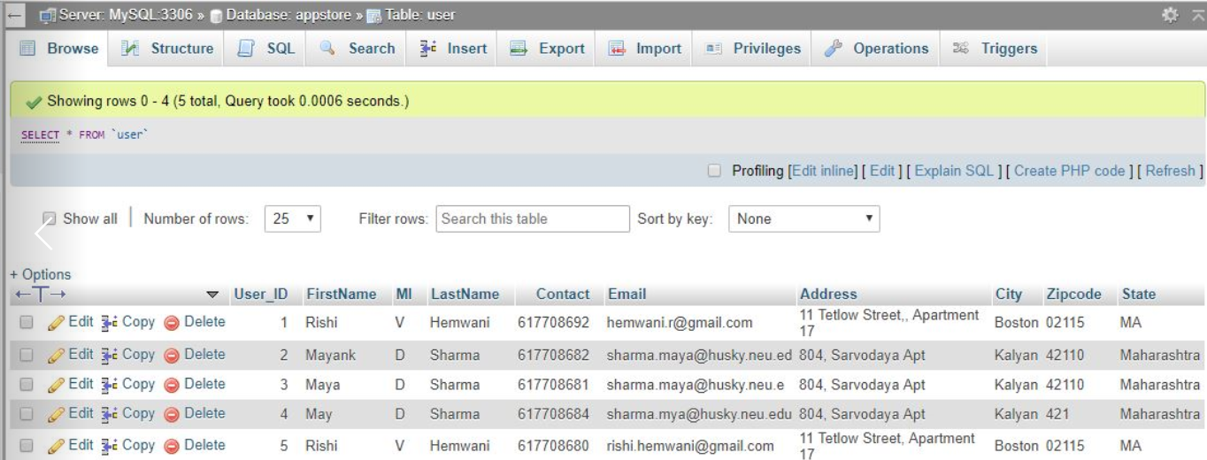
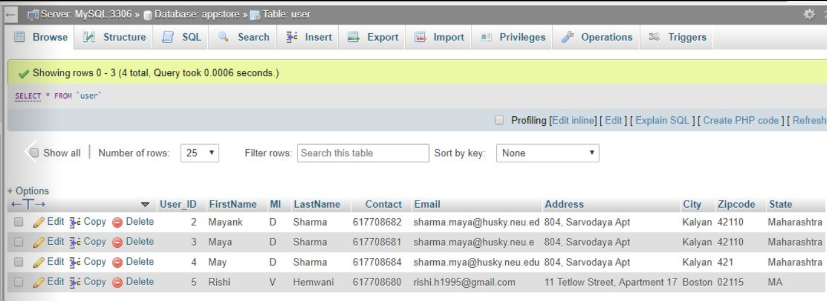
FLOW OF THE APPSTORE APPLICATION
User Table:
Before the user details get updated the user table has following entries.
After the user details get updated the user table has the updated entries.

Slide 19
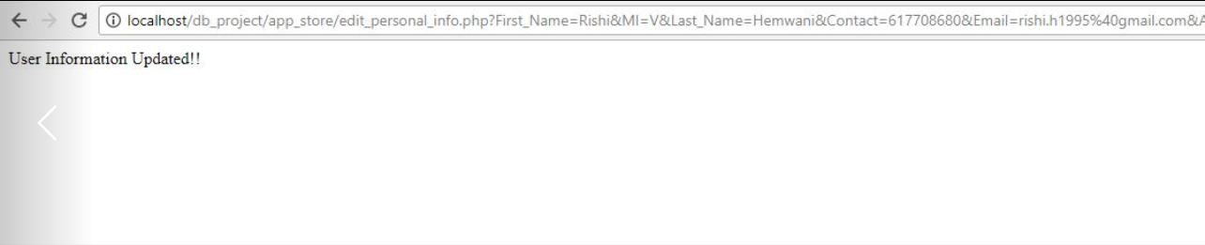
FLOW OF THE APPSTORE APPLICATION
User Table:
After the user details get updated in the database a final message gets printed saying “User Information updated”

Slide 20
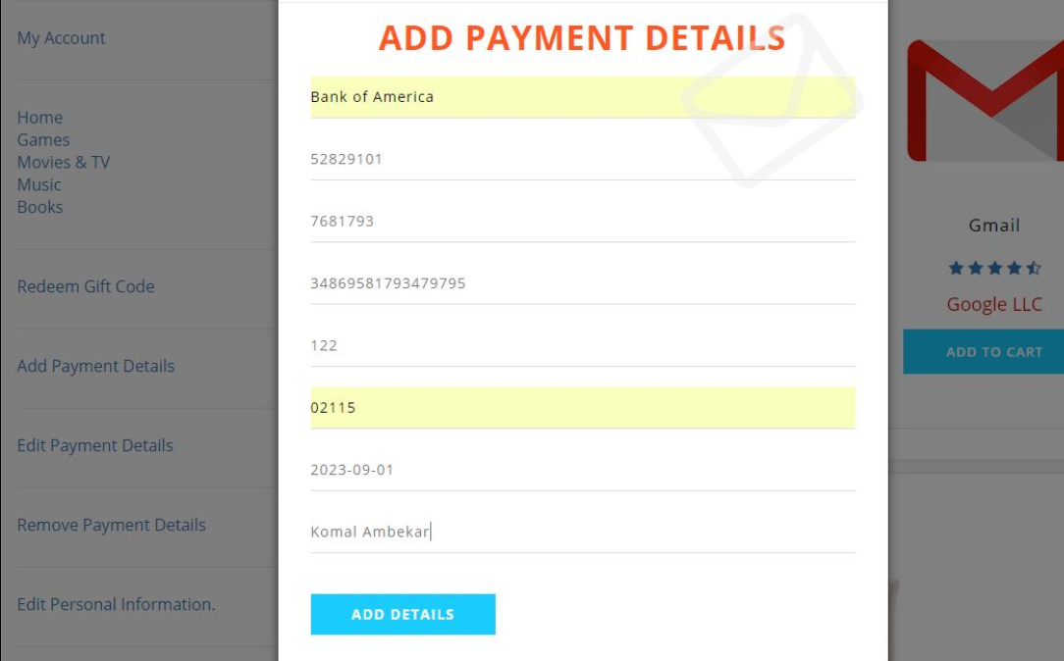
FLOW OF THE APPSTORE APPLICATION
Payment Table:
When the payment details have to be added ,click on the option on the left navigation bar.

Slide 21
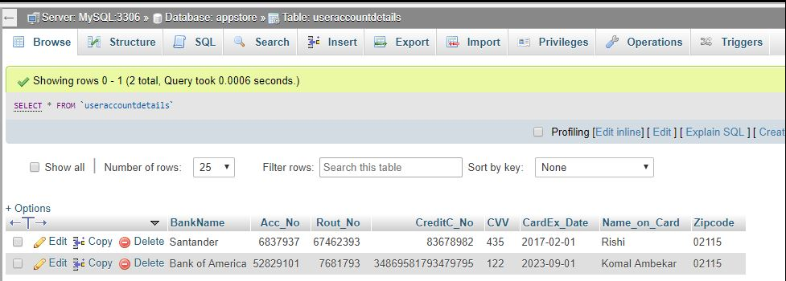
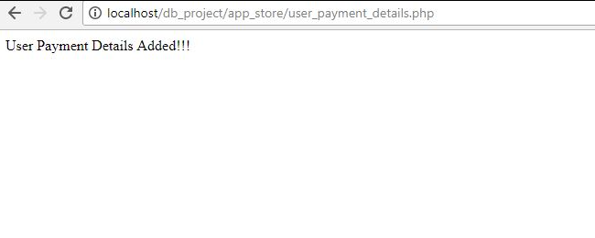
FLOW OF THE APPSTORE APPLICATION
Payment Table:
After the payment details have been added in database It shows as the latest entry in the payment table.
After the payment details get updated in the database a final message gets printed saying “User payment details added”

Slide 22
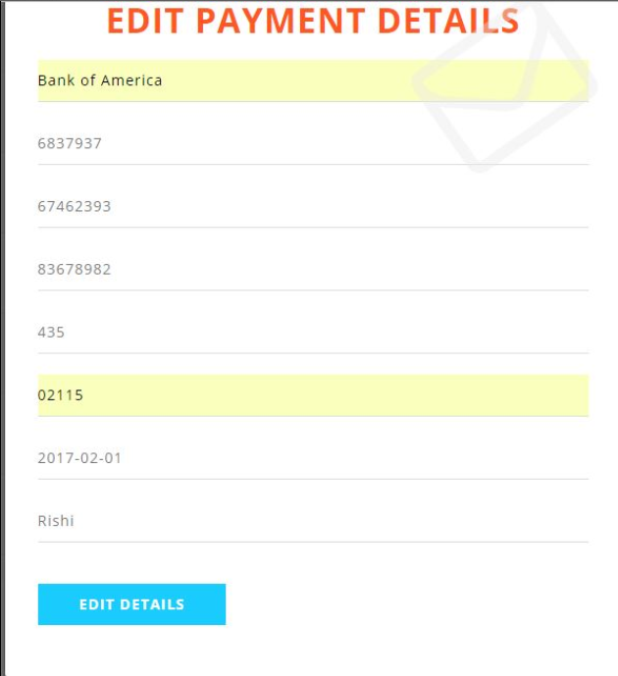
FLOW OF THE APPSTORE APPLICATION
Payment Table:
When any payment details need to be updated ,click on the option given at the left navigation bar

Slide 23
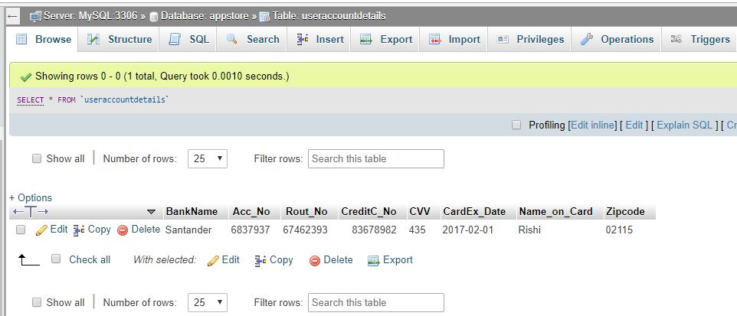
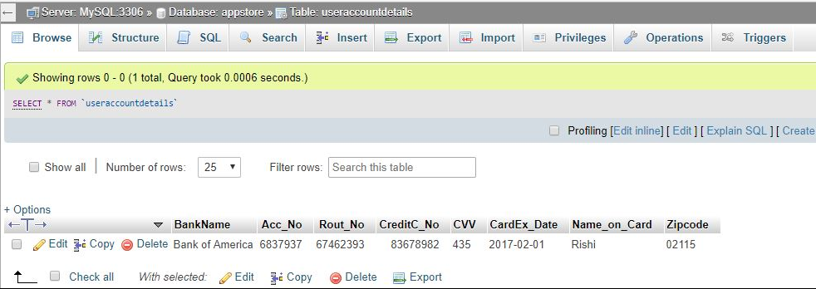
FLOW OF THE APPSTORE APPLICATION
Payment Table:
Before the payment details get updated the payment table has following entries.
After the payment details get updated the payment table has the updated entries.

Slide 24
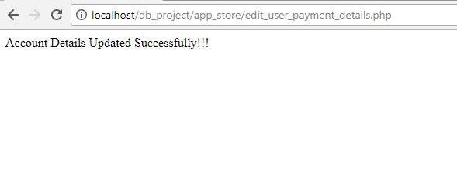
FLOW OF THE APPSTORE APPLICATION
Payment Table:
After the payment details get updated in the database a final message gets printed saying “Account details updated successfully”

Slide 25
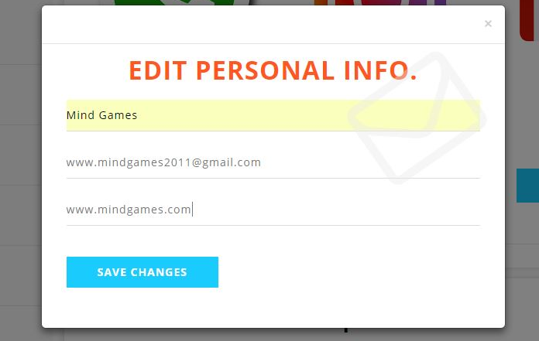
FLOW OF THE APPSTORE APPLICATION
Developer Table:
When any developer details need to be updated ,click on the option given at the left navigation bar

Slide 26
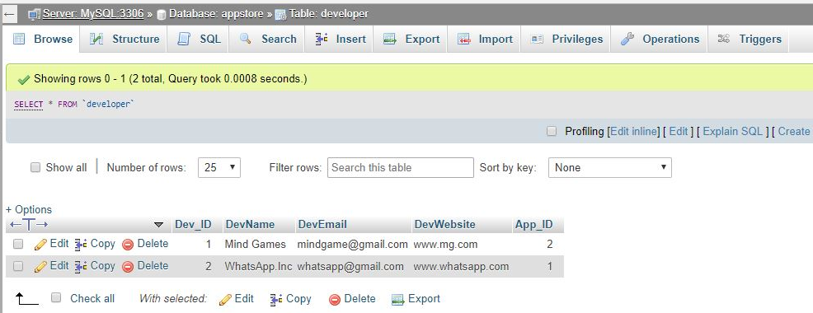
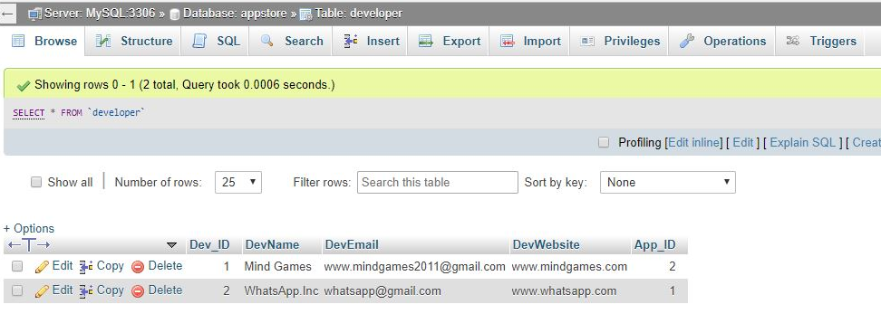
FLOW OF THE APPSTORE APPLICATION
Developer Table:
Before the developer details get updated the developer table has following entries.
After the developer details get updated the developer table has the updated entries.

Slide 27
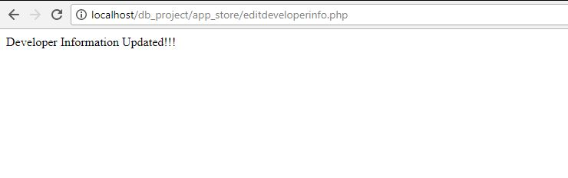
FLOW OF THE APPSTORE APPLICATION
Developer Table:
After the developer details get updated in the database a final message gets printed saying “Developer details updated successfully”

Slide 28
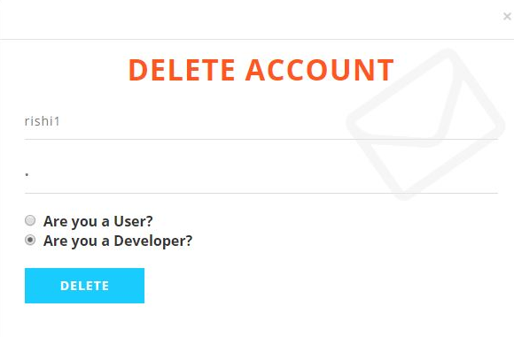
FLOW OF THE APPSTORE APPLICATION
Developer Table:
When any developer account need to be deleted ,click on the option given at the left navigation bar

Slide 29
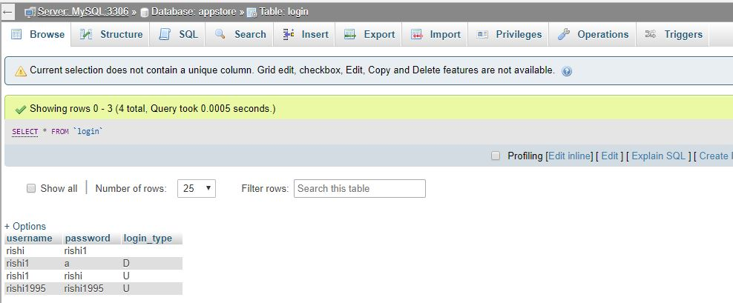
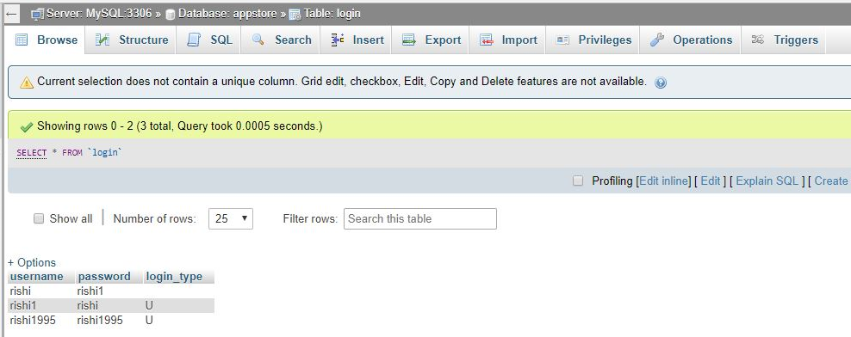
FLOW OF THE APPSTORE APPLICATION
Developer Table:
Before the developer account gets deleted the developer table has following entries.
After the developer account gets deleted the developer table has the updated entries.

Slide 30
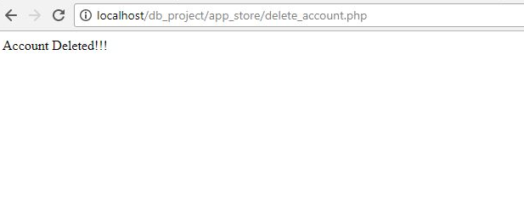
FLOW OF THE APPSTORE APPLICATION
Developer Table:
After the developer account gets deleted in the database a final message gets printed saying “Developer account deleted successfully”

Slide 31
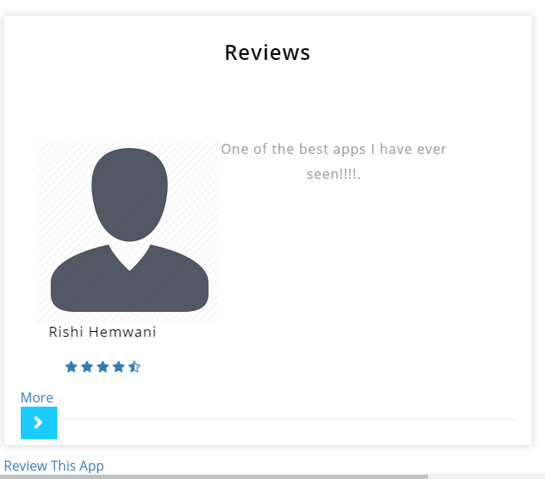
FLOW OF THE APPSTORE APPLICATION
Review Table:
The users can review those applications which they have downloaded only once.

Slide 32
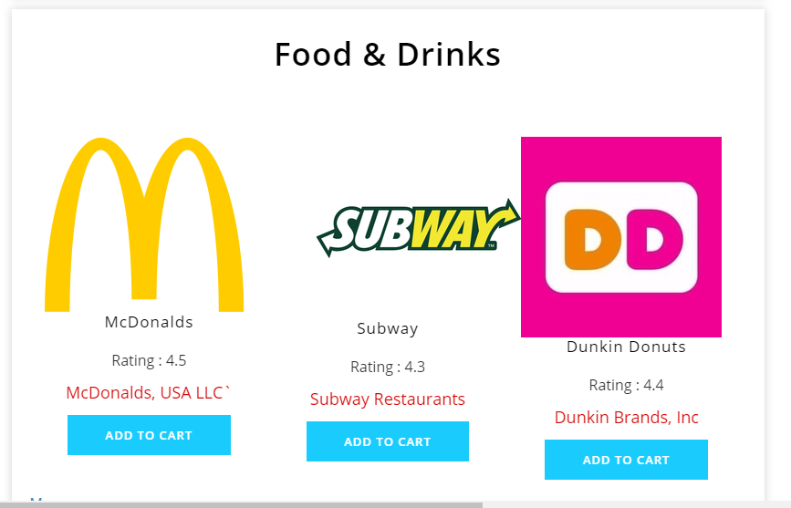
FLOW OF THE APPSTORE APPLICATION
Fetching Applications based on Categories:
Based on Popular categories, highly rated applications are fetched by joining application and categories table.

Slide 33
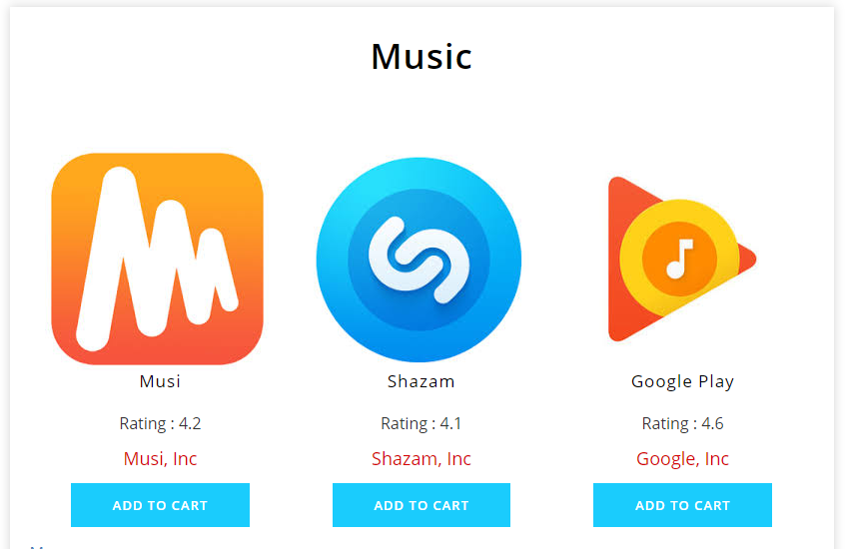
FLOW OF THE APPSTORE APPLICATION (Cont.)
Fetching Applications based on Categories:
Based on Popular categories, highly rated applications are fetched by joining application and categories table.

Slide 34
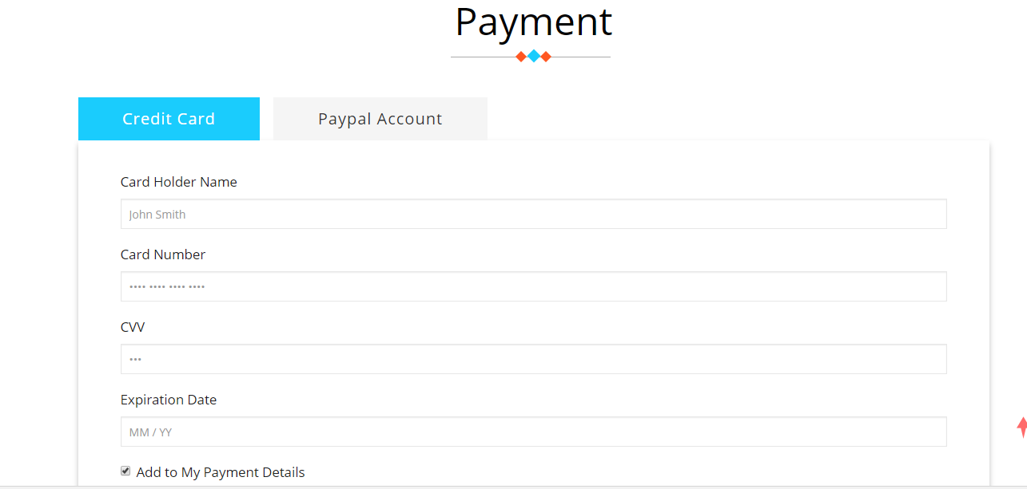
FLOW OF THE APPSTORE APPLICATION
Credit Card Details:
The user can provide new credit card details while paying the bill and the card details will be stored in the database.

Slide 35
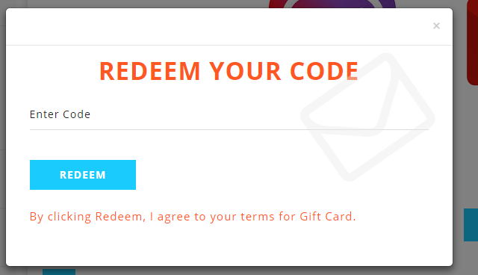
FLOW OF THE APPSTORE APPLICATION
Redeem Gift Card:
The user can redeem the gift coupon earned by him/her and can avail the discount in the original application price.

